Slide 1


Introduction To HTML Hyper Text Markup Language
Full-Stack Web Development Bootcamp

Slide 2

What is HTML?
Hyper Text Markup Language
HTML (Hypertext Markup Language) is the standard language used to create and structure web pages on the Internet. It provides the basic building blocks for displaying text, images, and links on websites.

Slide 3

What is HTML Used For?
HTML – The Skeleton
You can think of HTML as the skeleton of a web page. It provides the structure and defines where things go, while CSS (styles) adds the look and feel, and JavaScript adds interactivity.

Slide 4
History Of HTML
HTML 1.0 (1993):
Created by Tim Berners-Lee, HTML 1.0 was the first version of Hypertext Markup Language. It laid the foundation for web documents, focusing on simple text formatting and hyperlinks.
HTML 2.0 (1995):
HTML 2.0 standardized existing practices and introduced new features, including basic forms, for broader web usage. This version was overseen by the IETF (Internet Engineering Task Force).
HTML 3.2 (1997):
Developed by the W3C (World Wide Web Consortium), HTML 3.2 introduced more complex elements, such as tables, applets, and improved form controls, making the web more interactive.
HTML 4.01 (1999):
HTML 4.01 was a significant update, focusing on accessibility, internationalization, and separating structure from presentation with the introduction of Cascading Style Sheets (CSS). XHTML 1.0 (2000):
XHTML 1.0 was a reformulation of HTML 4.01 in XML, aiming for stricter syntax rules and better compatibility with XML tools. However, it never gained widespread adoption.
HTML5 (2014):
HTML5 was a major evolution of the language, incorporating new elements (e.g., <video>, <audio>, <canvas>), APIs, and support for modern web applications. It focused on building more interactive, media-rich websites and improving cross-device compatibility without relying on plugins like Flash.

Slide 5
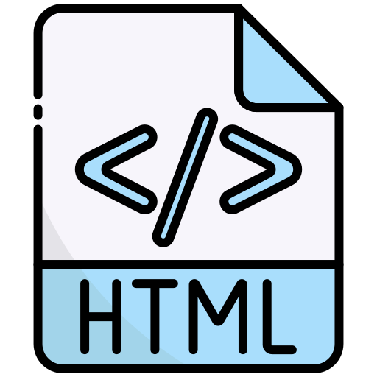
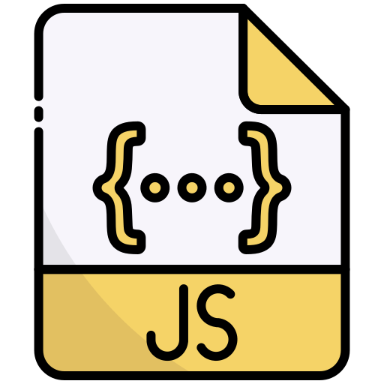
Programming Vs Markup Language
Markup Language
Programming Language
A markup language is used to structure and format content in documents, telling a browser or software how to display or arrange data. Examples include HTML and XML.
A programming language is used to write instructions that a computer can execute to perform tasks, make decisions, and manipulate data. Examples include Python, Java, and C++.

Slide 6
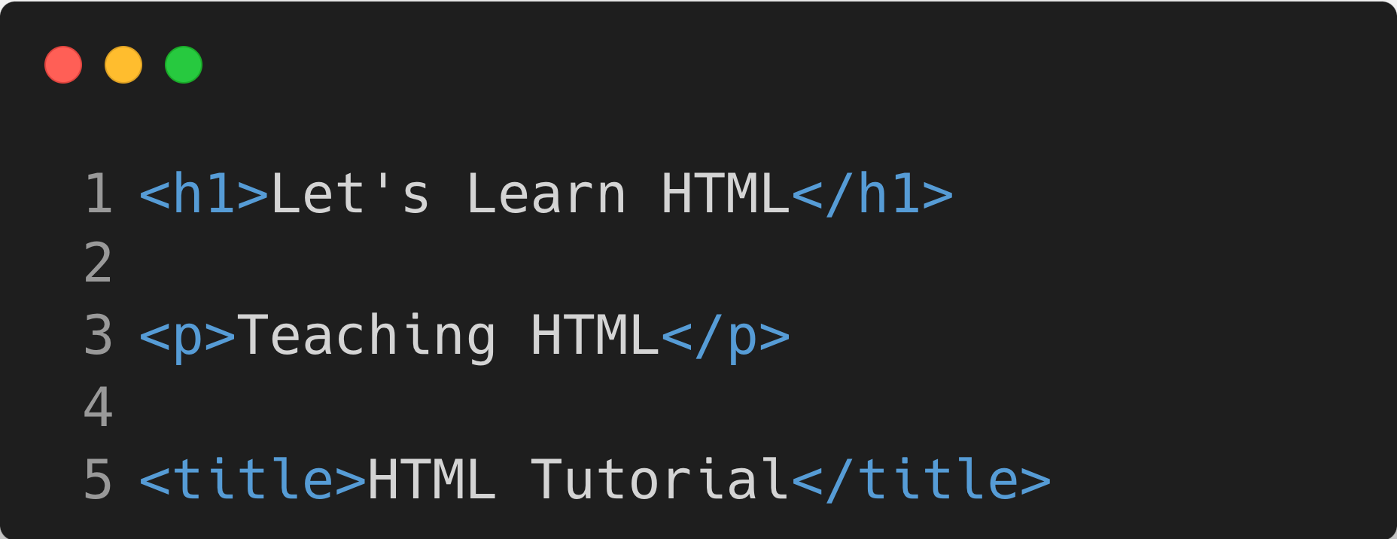
Introducing HTML Tags
HTML Tags and Elements
An HTML tag is a specific code element used to define and structure content on a web page. Tags are enclosed in angle brackets (e.g., <p>), typically come in pairs (opening and closing), and tell the browser how to display text, images, or other media elements.

Slide 7
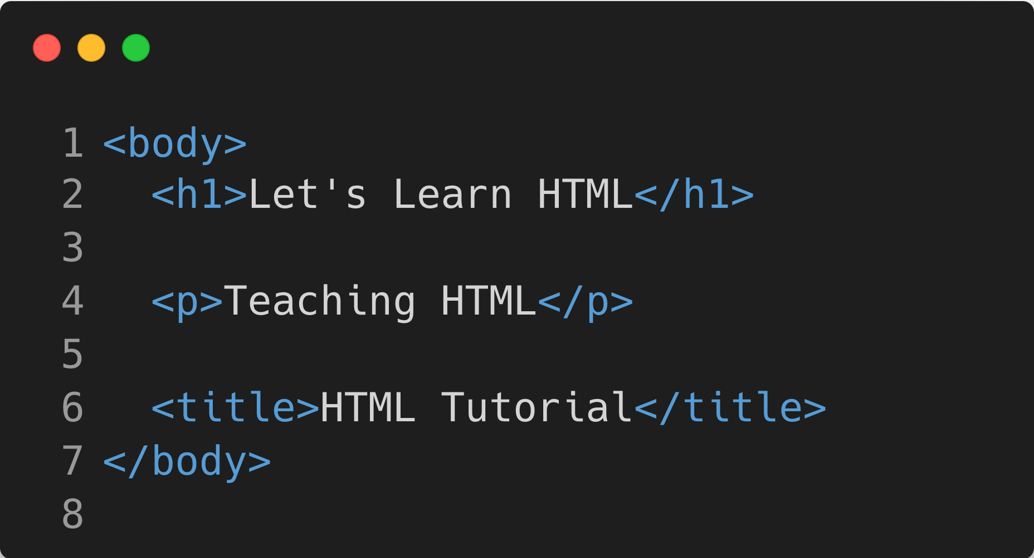
Nesting Of HTML Elements
Nested Elements
Nested tags in HTML refer to elements placed within other elements, creating a hierarchy of elements.
This structure allows for more complex layouts, where child elements inherit properties or are affected by their parent elements.

Slide 8
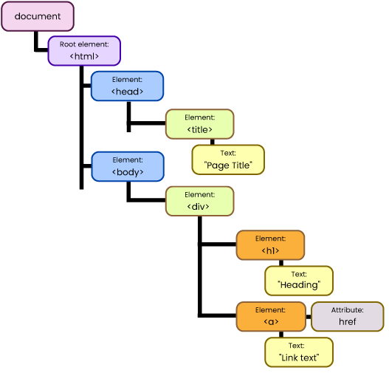
The Family Of HTML Elements
HTML has a tree-like structure where elements are organized in a hierarchy. Elements can have parent, child, and sibling relationships, similar to a family tree. Parent elements contain child elements, and sibling elements share the same parent within the HTML document.

